Slide 1


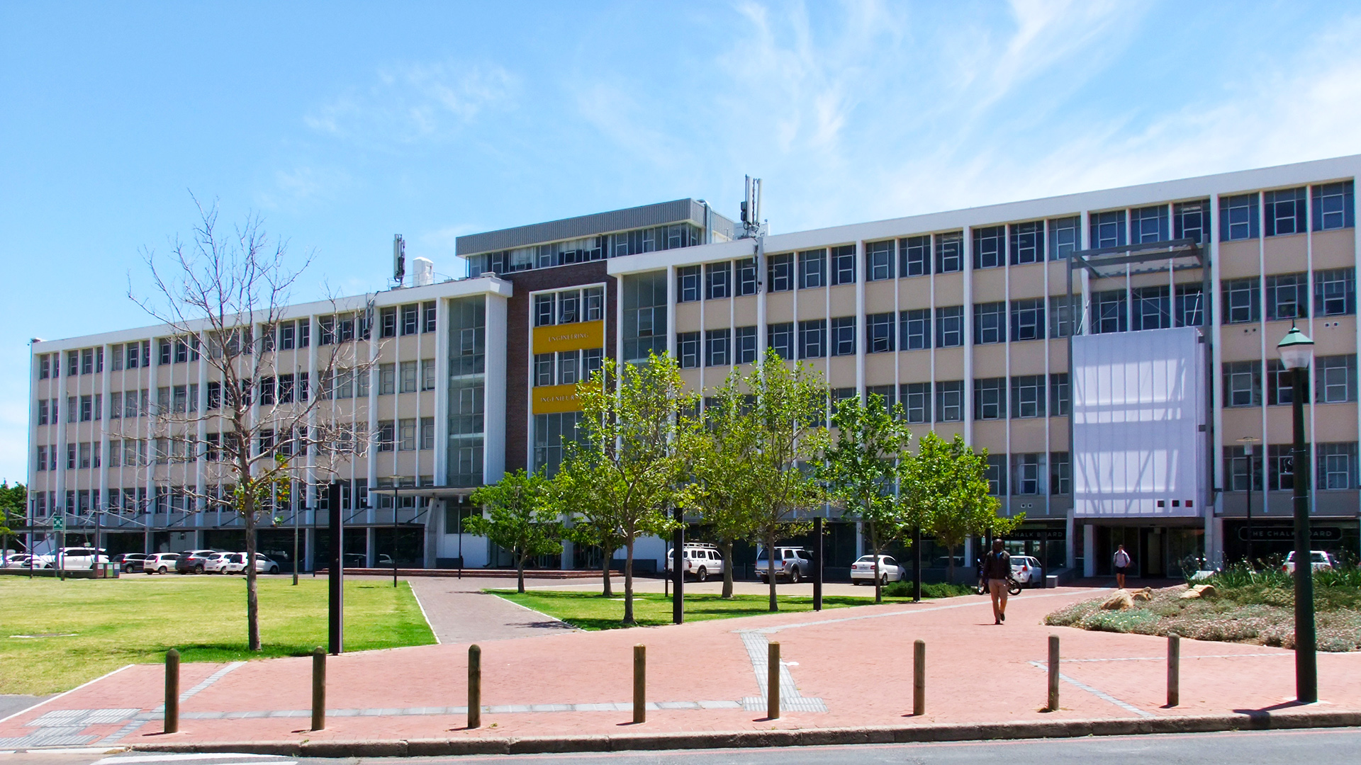
Weekly Meeting (10 March 2026) By Pieter Breytenbach
Photo by Stefan Els
Notes:
Picture placeholder slide layout
To change the picture:
Select the picture by clicking on it near the bottom of the slide (under the title placeholder), then click on the Picture Format tab.
Click on the Change Picture icon and choose the From a File/This Device… option.
Browse and select a picture and click on the Insert button.
Use the Crop command to adjust the image.
Click on the Crop command again to apply the changes.
Remember to add image attributions to photographs or artworks.

Slide 2
Last Week Meeting
Questions about GA 5
Conversation about Micro Robotics endoscope
Talked about the necessary complexity required for the skripsie.

Slide 3
This weeks progress
Literature Review
Started with design requirements for the laparoscope. Started compiling list of available products.
Played a bit with the endoscope

Slide 4
This weeks planned progress
Finish design requirements and product lists.
Start with concept designs.

Slide 5
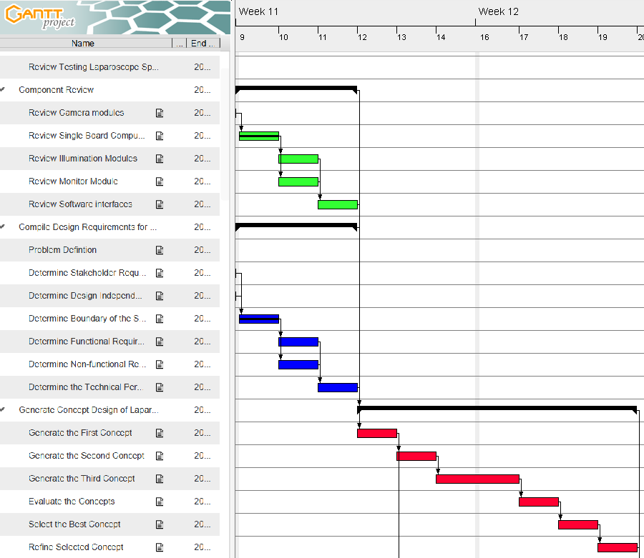
Gantt Chart

Slide 6
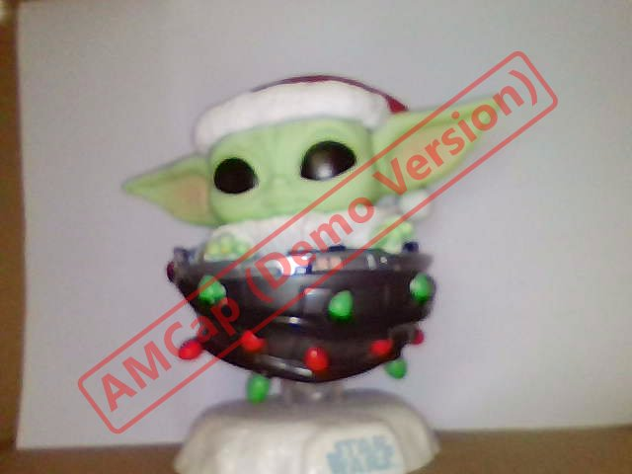
This is the Way

Slide 7
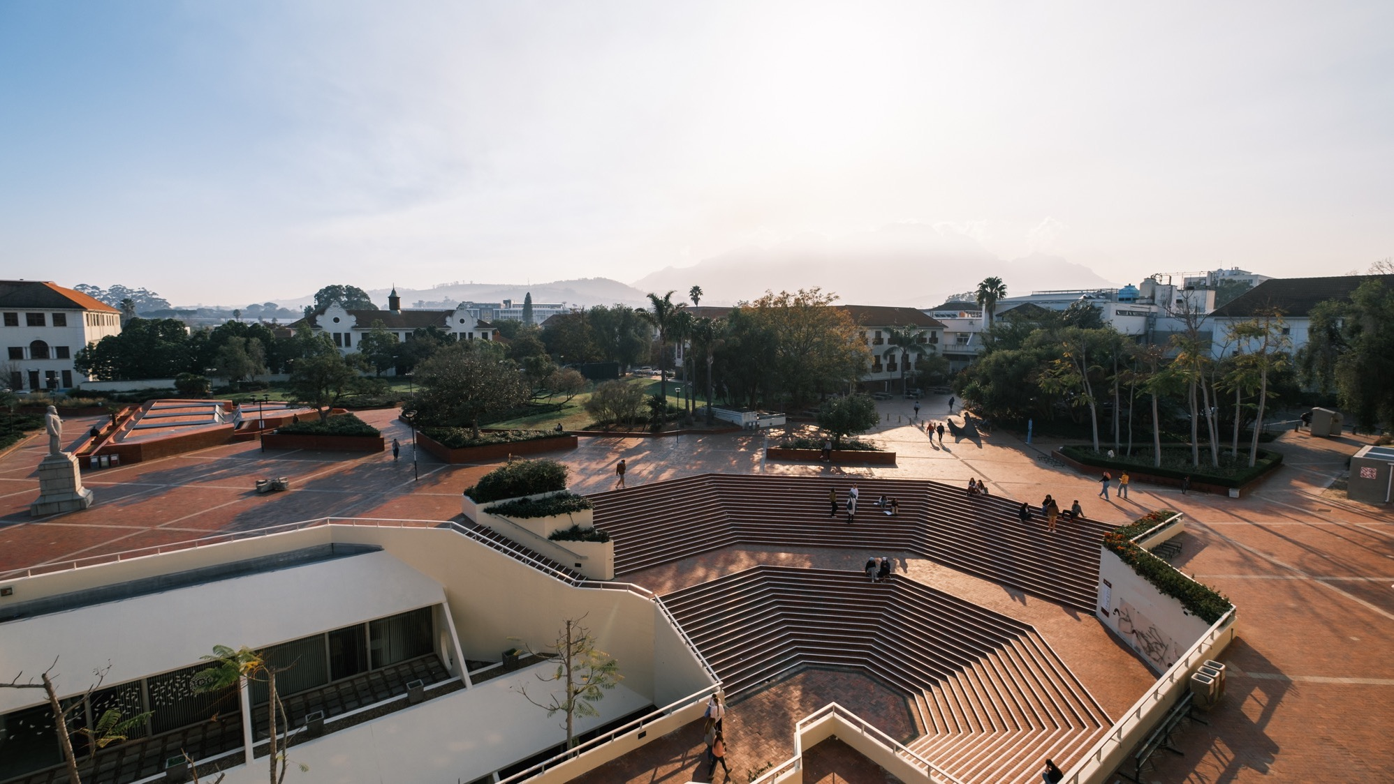

Thank you Enkosi Dankie
Photo by Stefan Els
Notes:
Cover/End slide layout
To change the picture:
Select the picture by clicking on it near the bottom of the slide (under the title placeholder), then click on the Picture Format tab.
Click on the Change Picture icon and choose the From a File/This Device… option.
Browse and select a picture and click on the Insert button.
Use the Crop command to adjust the image.
Click on the Crop command again to apply the changes.
Remember to add image attributions to photographs or artworks.

